Slide 1

Political Sentiment on Reddit

Slide 2
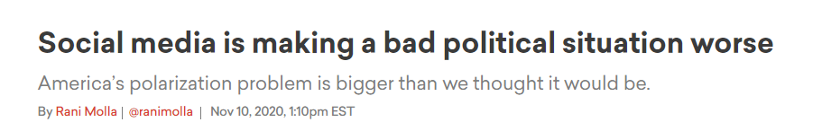
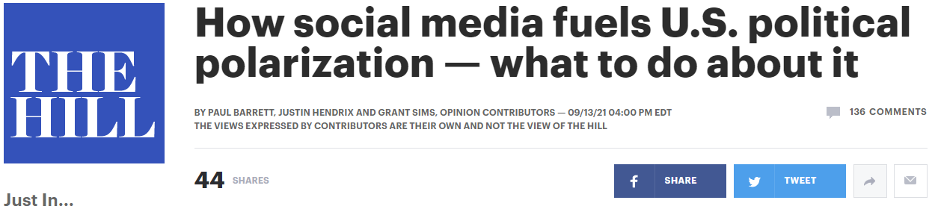
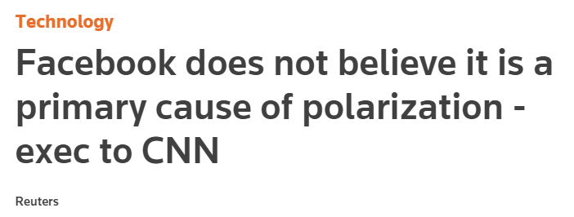
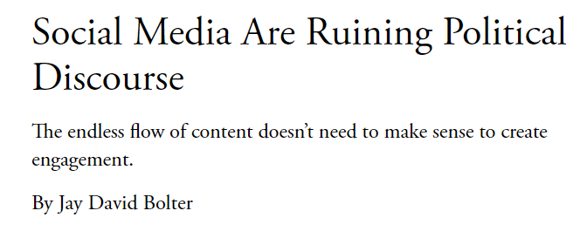
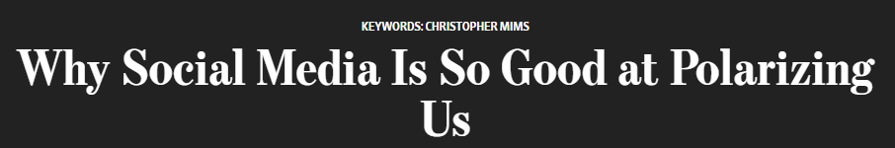
Notes:
The effect of social media on politics is a frequently discussed issue. Claims are often made by media outlets and regulators that social media is having a generally negative effect on political sentiment in the US—that social media creates “echo chambers” of like-minded people that lead to polarization and increasingly extreme views. Naturally, I was curious to see if this effect can be demonstrated. My first challenge was finding some sort of baseline statistic that indicates political sentiment in the US as a whole.

Slide 3
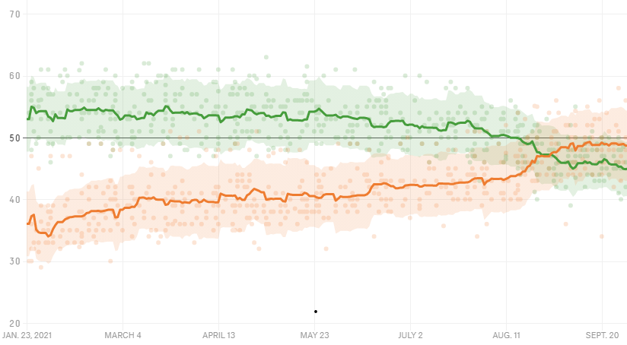
Presidential Approval Ratings
Notes:
After considering a few different metrics, I decided to use presidential approval ratings. Approval rating polls have been the main way to measure political sentiment in the US for decades, and polling processes are generally robust enough that we can feel comfortable that we are seeing a representative sampling of viewpoints.

Slide 4
The Data
Reddit:
r/politics and r/news: two largest general political subreddits
r/Conservative and r/Libertarian: two largest right-leaning subreddits
r/democrats and r/Liberal: two largest left-leaning subreddits
500k+ comments from about 134k author
Poll Data from FiveThirtyEight:
Presidential approval data from 40+ different pollsters
Date range: Jan 23 – Sept 15, 2021

Slide 5
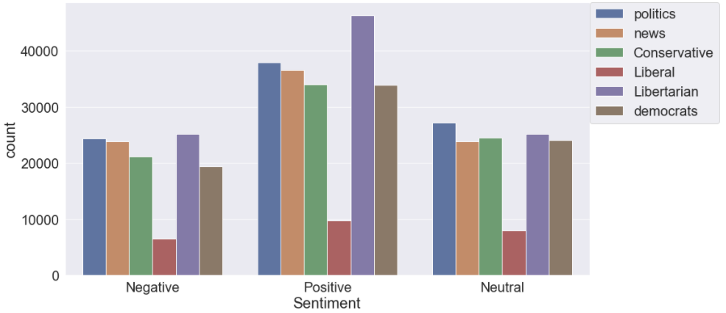
Sentiment of Reddit Posts
Notes:
First, I performed a sentiment analysis using TextBlob to get an idea of the sentiment of conversations. And what we see is really a very even distribution across the three classes. We don’t really see evidence that any subreddit is particularly negative

Slide 6
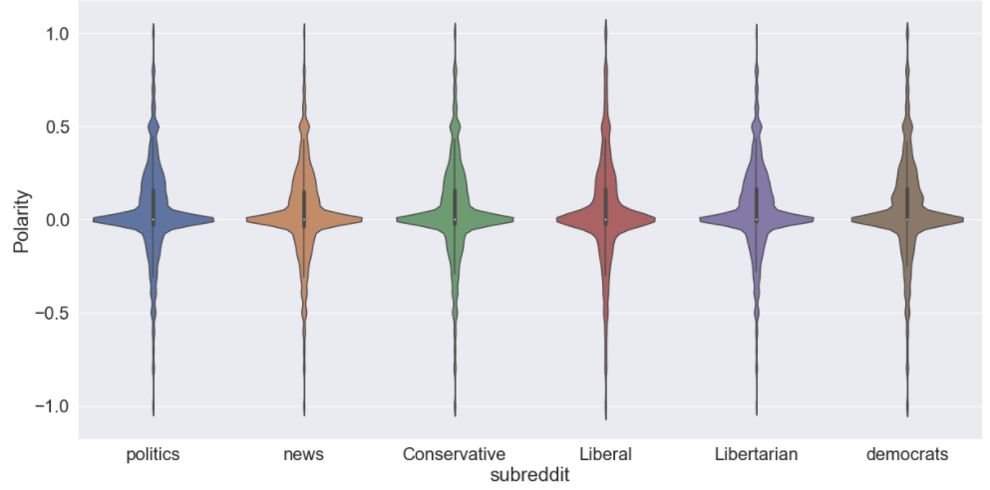
Sentiment of Reddit Posts

Slide 7
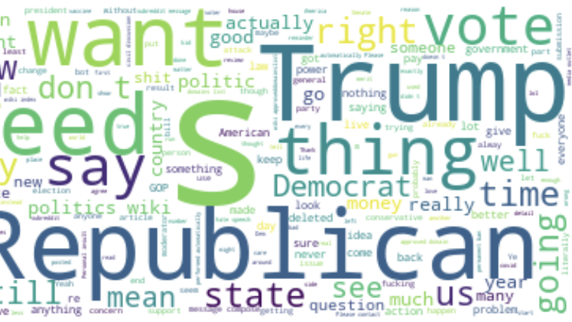
r/politics

Slide 8
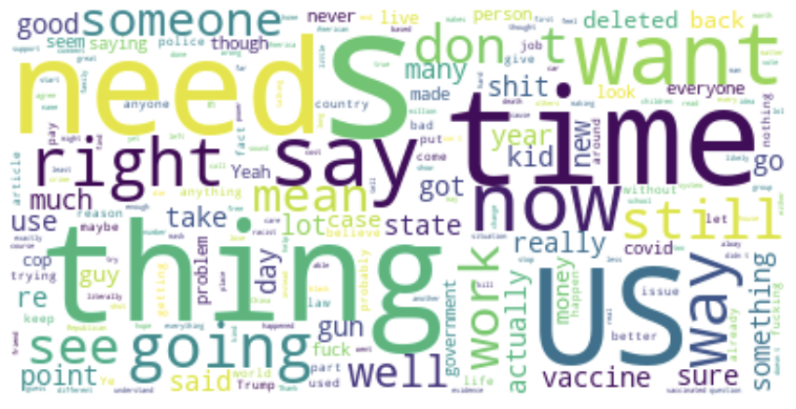
r/news

Slide 9
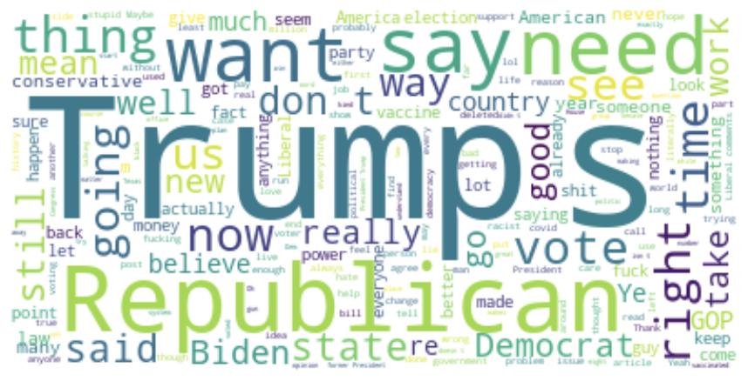
r/liberal

Slide 10
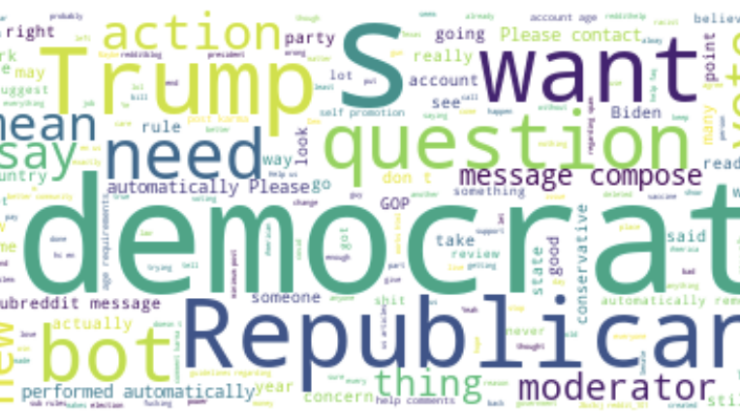
r/democrats

Slide 11
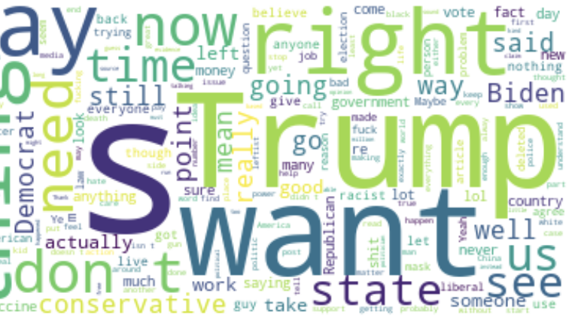
r/conservative

Slide 12
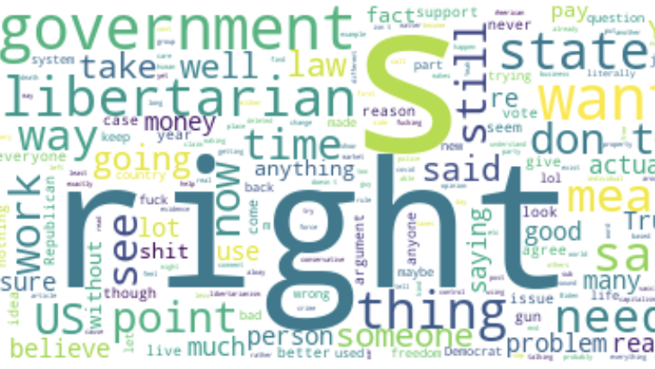
r/libertarian

Slide 13
Modelling Results
Notes:
Which brings us to modelling – where we can see if there is any correlation between the sentiment of reddit posts and our presidential approval rating. I considered using a time series model for this project, but ultimately I decided on a standard regression model instead because our approval ratings don’t demonstrate any seasonality.
Due to the sheer size of the dataset, I used only the top 1000 words in the dataset, along with the sentiment scores and the subreddit. And here’s what I found…

Slide 14
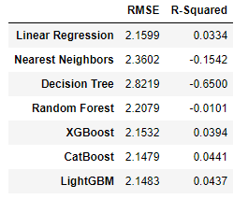
Notes:
Across all the models I fit, the r-squared is abysmally low—and even negative in some cases – which indicates that there is little to no relationship between our reddit comments and presidential approval ratings

Slide 15
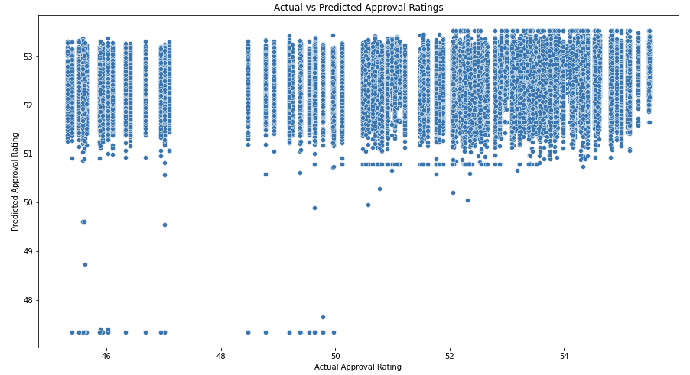
Notes:
Which can be seen even more clearly by plotting the actual approval ratings against the predicted approval ratings. If there was any sort of relationship between the two, we would expect to see the points resembling a diagonal line, but that doesn’t happen here.

Slide 16
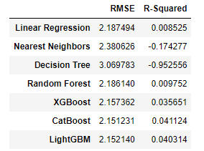
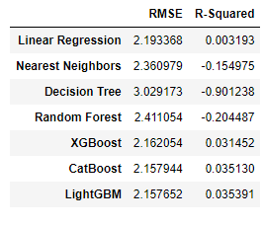
PCA
K-Means Clustering

Slide 17
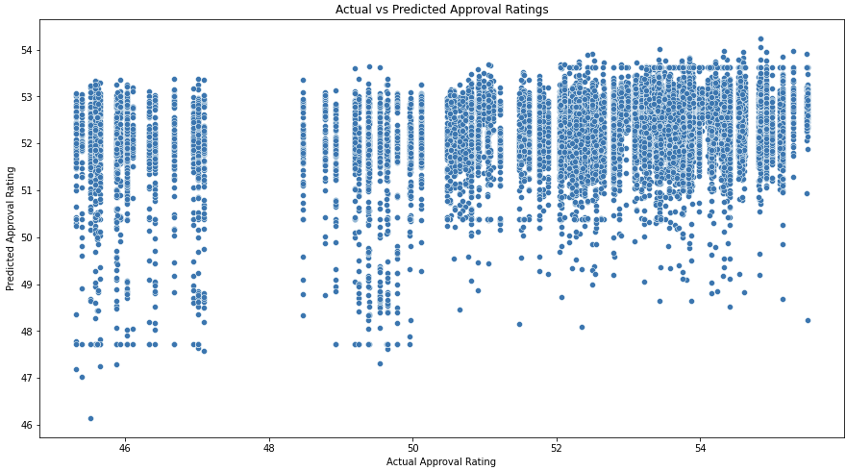
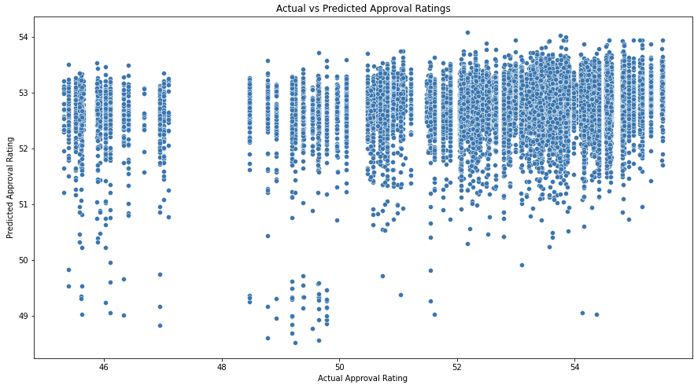
Left-leaning
right-leaning

Slide 18
Conclusions and Next Steps
There is no correlation between political sentiment on Reddit and political sentiment in the US at large, as measured by Presidential Approval Ratings
However, Reddit is not the only social media platform out there—analysis of Twitter, Facebook, and other platforms would help build a more robust analysis

Slide 19
Thank you!

